Slide 1

FROM INTRALIBRARY
TO
INTERLIBRARY LOAN
Sharing Resources to Learn, Serve and Grow
Ronald Figueroa
Interlibrary Loan Supervisor
IDS Project Conference
August 2nd , 2013

Slide 2

INTRODUCTION
Resource sharing is a vital aspect of the environment of libraries today. We all depend on each other to fulfill patrons’ needs and provide better services. While the relationship among libraries makes this possible, we should not forget that everything must begin in-house where cooperation between units is essential.

Slide 3
GOALS
GOALS
Provide an overview of the Paging/ILL service
Emphasize the importance of sharing resources. In-house cooperation.
Suggest best practices for similar projects
Share information

Slide 4
OVERVIEW
University of Miami
A private research university with more than 15,000 students
University of Miami Libraries
The libraries of the University of Miami rank among the top research libraries in North America with a combined collection of over 3.2 million volumes, with 74,000 current electronic and print serials.
The libraries are located on the Coral Gables, Rosenstiel, and Medical campuses. Richter and Affiliated Libraries include: Architecture, Business, Marine, Music, and Richter. The Law and Medical libraries are administered independently.

Slide 5
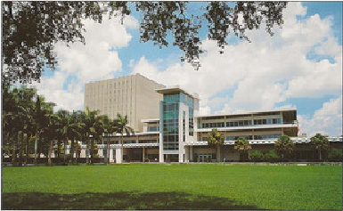
OVERVIEW

Slide 6

FIRST APPROACH
REQUEST/HOLD OPTION
2009

Slide 7
FIRST APPROACH
In 2009 the Access Services Department at the Otto G. Richter Library decided to offer patrons the Item Request Service called “Paging.”
Patrons request items through the catalog
Window of 24 to 48 hours to find the item
Circulation was the unit in charge of the project.

Slide 8
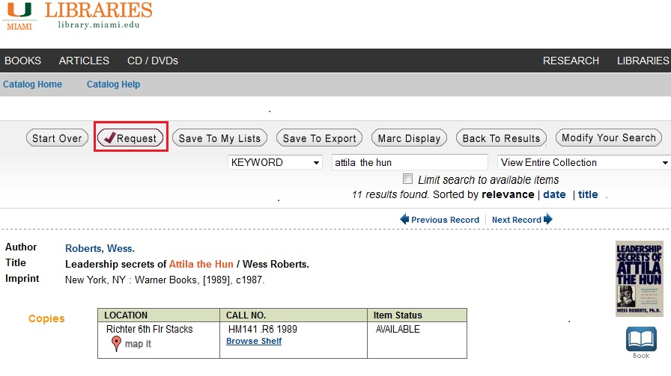
FIRST APPROACH

Slide 9
FIRST APPROACH
Paging Service
Circulation
System: Millennium
A list of items printed twice a day (AM, PM)
Student Assistants and Staff would do paging

Slide 10
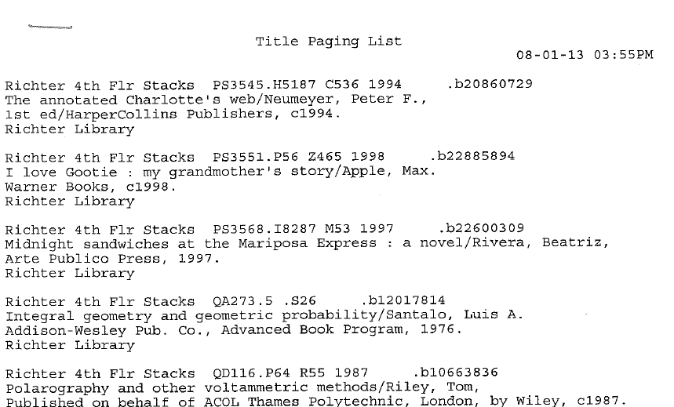
FIRST APPROACH
List Format

Slide 11
FIRST APPROACH
Item Found
Item checked in to fulfill hold
Email sent to patron indicating Item was ready
Item placed at Circulation Hold Shelf
Item Not Found
Hold was cancelled
Status changed to “Second Search”
Email sent to patron indicating Item was not found and suggested to try Interlibrary Loan
Item became a “trace.”

Slide 12
FIRST APPROACH
Document Delivery
Interlibrary Loan
Patrons request items to Interlibrary Loan through the ILLiad webpage. Some of those items are held by the library or it’s branches.
System: ILLiad
ILL borrowing staff check the catalog (Z39.50) and route request to the Doc Del Module in ILLiad
ILLiad slips are printed once a day
ILL Student Assistants search the stacks

Slide 13
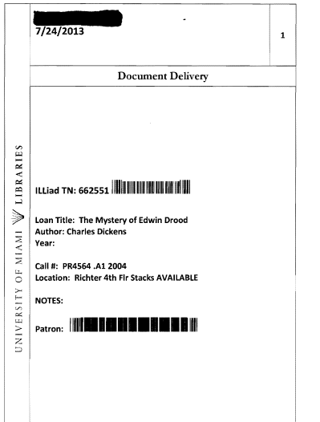
FIRST APPROACH
Document Delivery Slip

Slide 14
FIRST APPROACH
Item Found
Hold is added to patron record
Item checked in to fulfill hold
Email sent to patron indicating Item was ready
ILLiad updated to “Request Finished in Doc Del”
Item placed at Circulation Hold Shelf
Item Not Found
Request is routed back to the Borrowing module
Status changed to “Second Search”
Circulation procedures
Request fulfilled through Interlibrary Loan. Patron gets item.

Slide 15
FIRST APPROACH
Paging Service
YR | Total Paged | Found | Missing | %
2011 | 10360 | 8113 | 2247 | 78

Slide 16
FIRST APPROACH
The Issue
Two units within the same department doing basically the same procedure with different approaches and different results for the patron.
Circulation
Paging
Searching a List
ILL
Document Delivery
Lending Approach

Slide 17
NEW PLAN
JUNE 2012

Slide 18
NEW PLAN
PROPOSAL
Patrons should submit the request only once. It is us working at the Library the ones in charge to route the request between units and get the item. Requests not found through the Paging Service will be routed to Interlibrary Loan for eligible patrons.
3 units will participate Circulation, ILL and Stacks Maintenance
Systems Millennium and ILLiad
ILL will lead the project

Slide 19
NEW PLAN
REACTION
“There’s no point to add ILL to this service?
“Patron should know what to do. Why us?”
“Paging is good as it is”
“It’s no going to work”
“It’s a good idea but there’s no need to add more work to us here at ILL”
“Ron, you’re crazy”

Slide 20
NEW PLAN
PLAN
2 searches per day. ILL (AM) Circulation (PM)
Slips or list of items printed from Millennium
All students assistants from all 3 units will be trained by ILL
ILL Supervisor and Head Lender would keep statistics in Excel
2 supervisors from Access Services were trained as back up
Items not found on the first search would be searched for 3 more days.
On the fourth day “items not found” would be routed, by Head Lender, to ILLiad.
To lower ILL cost request would be sent to reciprocal libraries.

Slide 21
NEW PLAN
Item Found
Hold is added to patron record
Item checked in to fulfill hold
Email sent to patron indicating Item was ready
Item placed at Circulation Hold Shelf
Item Not Found
Request added to Borrowing for those eligible. 75% of patrons have already an account with ILL
Patron receives an email indicating the request has been routed to ILL.
Status changed to “Second Search” in Millennium
.

Slide 22
NEW PLAN
FIRST ISSUES
Stacks Maintenance was given another project and could not participate. Only Circulation and ILL
Millennium templates are very difficult to customize
AM and PM shifts were having different results during searching

Slide 23
NEW PLAN
Millennium Templates
Very difficult to customize.
IReport
Lists vs. Slips
At first most participants preferred a list over slips but they did not like the regular list.
SOLUTION
A new list format created

Slide 24
NEW PLAN
Old Format

Slide 25
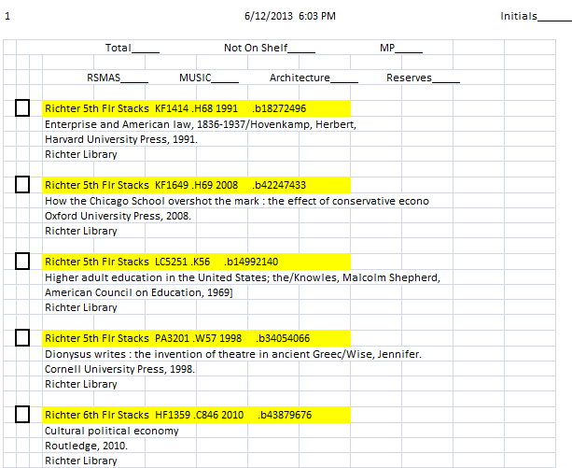
NEW PLAN
New Format

Slide 26
NEW PLAN
AM and PM shifts with different results
Morning Shift: 94 % ILL students trained to search for Lending
Evening Shift : 63% Circulation Staff
SOLUTION:
Lending Approach
Make sure everybody understands Call Numbers
Search shelf, sorting area, book trucks
Have an open mind and look for clues

Slide 27
Results

Slide 28
RESULTS
FY | Total Paged | Found | Not Found | ILL | %
2013 | 14815 | 12739 | 2076 | 472 | 86
472 ILL
991 non-ILL eligible: Law, Medical, Alumni, External user
354 found through other means
Total from these numbers is 1817.
Difference between “Not Found” 2076 – 1817 = 259
259 “Hiccups” in Millennium

Slide 29
RESULTS
Results Comparison
Paging (old Approach):
YR | Total Paged | Found | Missing | %
2011 | 10360 | 8113 | 2247 | 78
Paging/ILL (New Approach):
FY | Total Paged | Found | Not Found | ILL | %
2013 | 14815 | 12739 | 2076 | 472 | 86

Slide 30
RESULTS
Better cooperation between Circulation and ILL by sharing resources
Staff and Student Assistants are trained better
Other units of Access Services have seen the improvement of services and want to participate (teamwork)
Disorganized shelves are reported sooner to Stacks Maintenance
Better patron satisfaction
The Access Services Department provides a better and more meaningful service
We share resources and knowledge with a better approach..

Slide 31
RESULTS
REACTION
Patrons
“It’s very kind from you to go the extra mile to help with my research”
“I know I can submit a request and somehow you will get it for me”
“This service is very reliable ”
Staff
“The educational value of the project is priceless ”
“We have better ways to search”
“It worked! ”

Slide 32
Enhancements

Slide 33
ENHANCEMENTS
Make ILLiad talk to Millennium to import requests
Customization of Millennium templates

Slide 34
Best Practices

Slide 35
BEST PRACTICES
It is hard and difficult to approach change. Most likely the first suggestions or ideas will not fly. Don’t give up, find a way.
Plan ahead and be realistic.
Make sure all people involved are trained the same way.
Be Prepared! There is always something that may not go according to plan
Have an open mind.
Know your area, tools, technology, foes
Back up your data (hard and electronic)
Have more than one plan
Be ready to improvise
The key is to share resources
There is still a lot to do and learn

Slide 36
CONCLUSION

Slide 37
CONCLUSION
Libraries provide services everyday to fulfill patrons’ needs. If we start sharing resources among our units we guarantee more successful services.

Slide 38
Contact Information
Ronald Figueroa
Interlibrary Loan Supervisor
Otto G. Richter Library
University of Miami
rxfigueroa@miami.edu

